Slide 1
Junior research project preproposal
Kadin Ali
Teacher – Crowe
Fields – Physics and machine learning

Slide 2
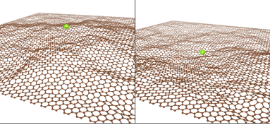
Current research
Currently, doped graphene, specifically n- and p- doping, has shown to have a property of electron excitation when stimulated by a photon (Johannsen, J. C., Ulstrup, S., Crepaldi, A., Cilento, F., Zacchigna, M., Miwa, J. A., … Hofmann, P., 2014). This means that when the graphene layer is exposed to a photon, an electron will rise to an excited state, fall, and release energy which will in turn cause on average two more electrons to rise and fall in a chain effect. This process multiplies the power of light per say, and could be a method of improving the efficiency of solar panels since this energy transfer is highly efficient.
Another property of graphene discovered was the display of Brownian motion in intrinsic graphene (Ackerman, M. L., Kumar, P., Neek-Amal, M., Thibado, P. M., Peeters, F. M., & Singh, S., 2016). This motion causes a graphene plane to suddenly invert at times, and when hooked up to a series of electrodes, could be used as a power source. The energy sourced from this process increases exponentially with the size of the graphene plane, which was measured from 10 nanometers to 10 microns (10,000 nanometers).
Both of these experiments were conducted in a vacuum chamber.

Slide 3
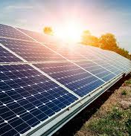
Purpose
With this research project, I plan to utilize the aforementioned electron excitation property of graphene in order to outsource power to a lightbulb that causes this property in a self-powered cycle. Then machine learning will be used to find the size, position, and amount of graphene planes needed for the predicted maximum efficiency of the system. Multiple planes of graphene positioned in different areas around the bulb may be needed to utilize a greater amount of photons, as well as possibly integrating the idea of a source powered by the Brownian motion displayed.
This project could possibly create either an extremely efficient source of power to be integrated into items such as solar panels, or even a new source of power in a self-powered cycle.
https://www.azocleantech.com/images/Article_Images/ImageForArticle_723(1).jpg

Slide 4
How it will be accomplished
To go through with this experiment, a vacuum chamber, doped graphene, and a device to measure electrical current such as a microammeter. The general procedure will work by setting up a system of a light source, graphene, and the device, and measuring the electrical current produced at different positions, sizes of graphene, and amount of layers.
The system does will have an external power source as the goal at this point is to simply measure the total output, the input for additional items and any loss of energy to the environment from self-input can be calculated at a later time.

Slide 5
Resources
Ackerman, M. L., Kumar, P., Neek-Amal, M., Thibado, P. M., Peeters, F. M., & Singh, S. (2016). Anomalous Dynamical Behavior of Freestanding Graphene Membranes. Physical Review Letters, 117(12).doi:10.1103/physrevlett.117.126801
Johannsen, J. C., Ulstrup, S., Crepaldi, A., Cilento, F., Zacchigna, M., Miwa, J. A., … Hofmann, P. (2014). Tunable Carrier Multiplication and Cooling in Graphene. Nano Letters, 15(1), 326– 331. doi:10.1021/nl503614v

